Slide 1
COSMOS: Cluster #11 Intro to Autonomous Vehicles
Introduction to Python
Presented by Moises Lopez
Slides by Kishore Nukala
ECE Grad Student

Slide 2
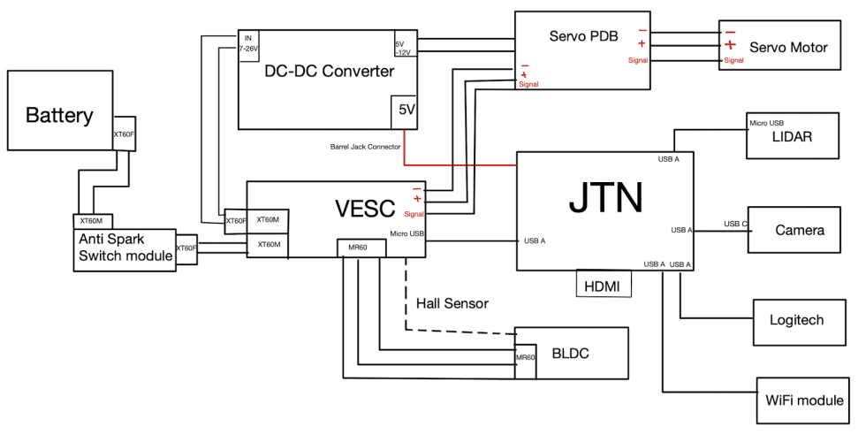
Objective of the Cluster:

Slide 3
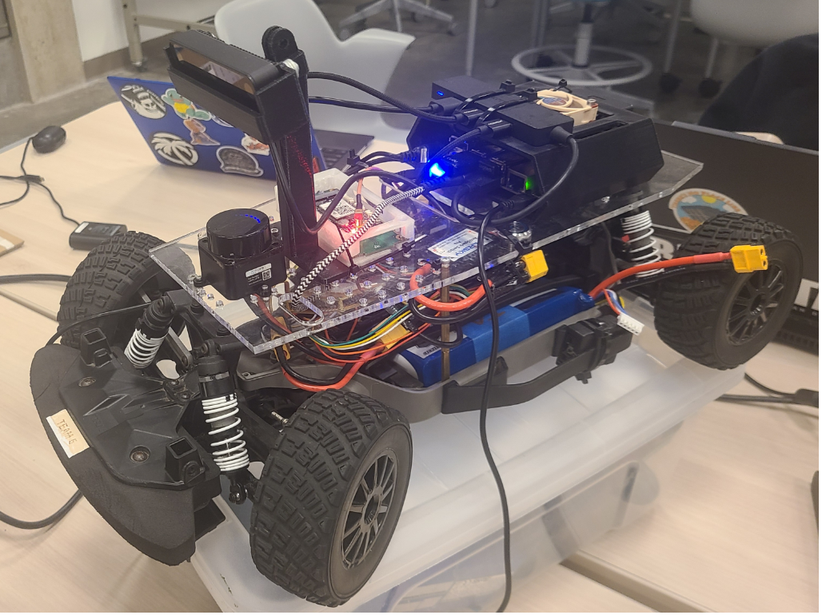
Objective of the Cluster:

Slide 4

What is Programming?
Programming is the act of creating instructions to be carried out by a computer to perform an action .
CODE: Set of commands that can be given to a computer
PROGRAM: Collection of lines of code that serves a particular set of required functions.
COMPILE: To Translate human readable computer code into instructions that can be understood by the computer for further execution
EXECUTE: Execute the code implies the step where the computer actually implements the instructions present in the code.
“A successful compilation of the code doesn’t ensure a desired output”
Notes:
Also explain Error and Debugging

Slide 5
Programming Language
Low level Language (PASCAL,COBOL etc..)
High level Language ( C, C++, Python etc..)
Based on the compiler, programming languages can be classified as:
Static ( Compiled languages):
Static type language checks for any violation before running the program
Memory allocation is done during compilation
Dynamic ( Interpreted languages):
The error is given when the program is running and goes to the part where violation has been done.
Memory allocation is done during run-time

Slide 6
Python
https://docs.python.org/3/tutorial/
IDE:
IDE stands for the integrated development environment (IDE). IDE Provides an Environment consolidated for the Programmer to write a Computer Program.
IDE helps in combining common activities of writing software into a single application such as editing source code, building executables, and debugging. IDE is basically an Environment or Combination of tools like a text editor, debugger, and Compiler.
https://www.jetbrains.com/idea/
You can also use a source code editor
https://code.visualstudio.com/download

Slide 7
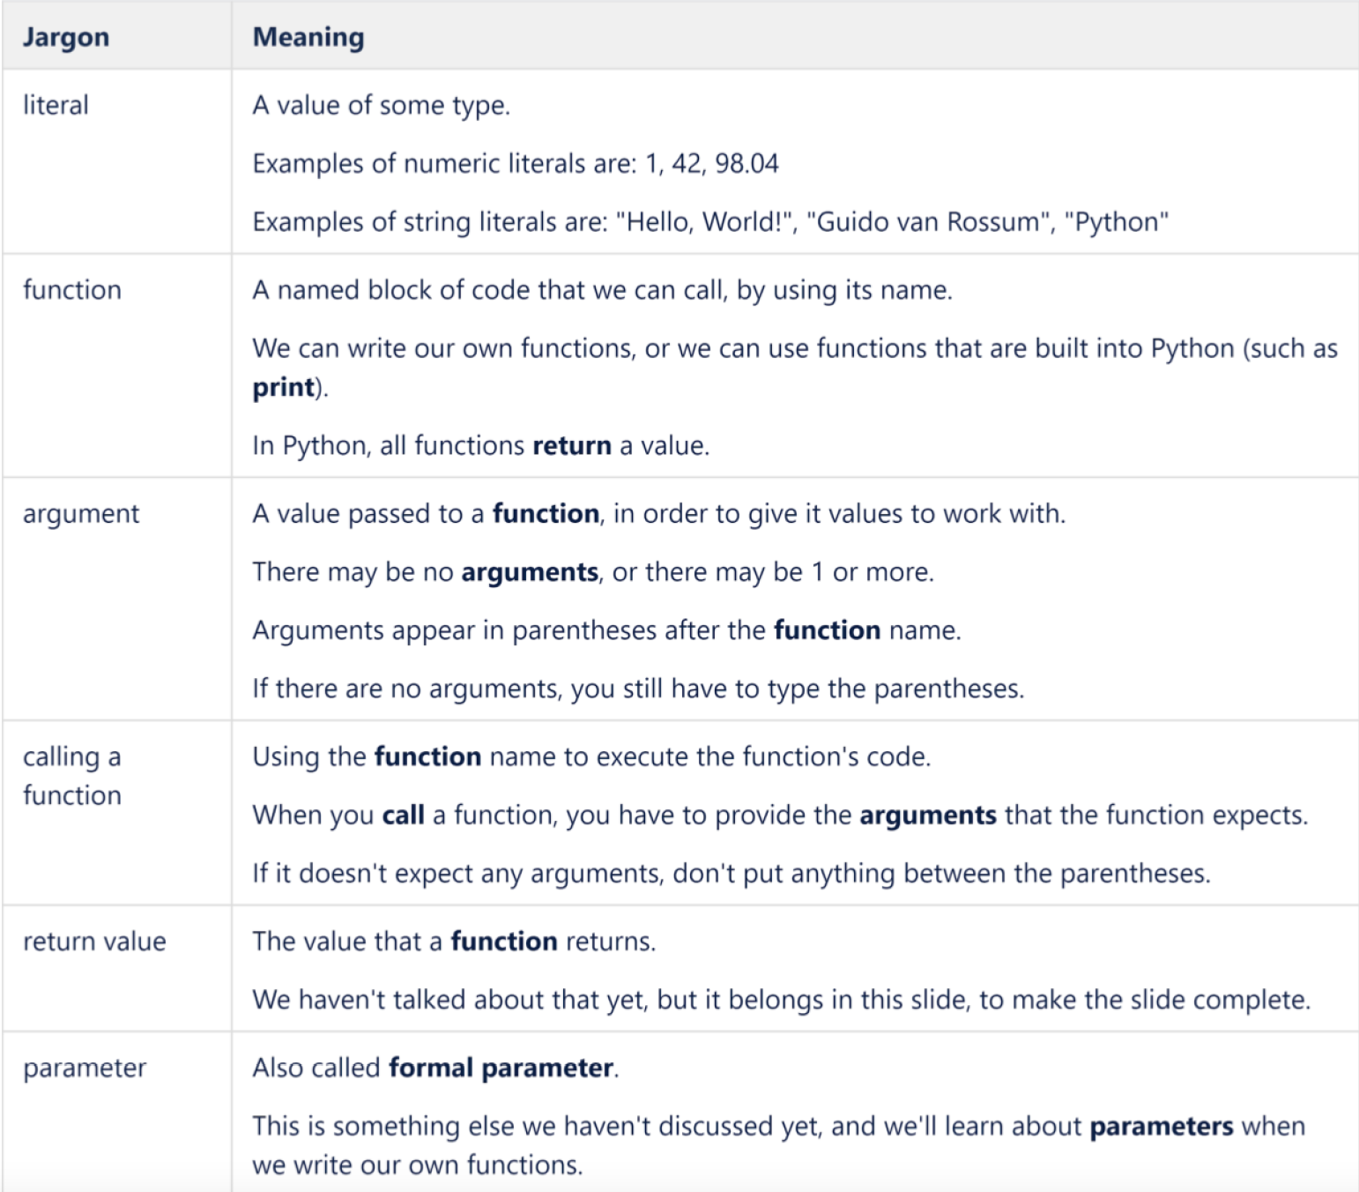

Slide 8
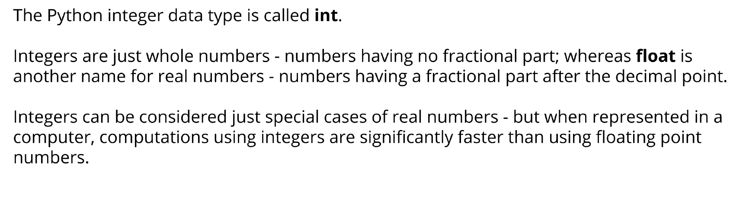
Integer and Float data types:
Generally, in other programming languages there is a limit on the maximum size of the int value where as in Python there is no limit and as the number is increased the program crashes by running out of memory, but no error will be produced for size limit.

Slide 9
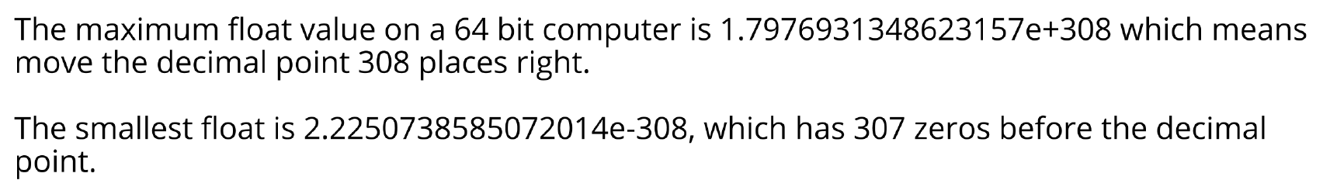
Integer and Float data types:
Floating point numbers or floats are the numbers that have a fractional part. In Python floating point numbers are represented using float datatype.
Python floats have 52 digits of precision
Let's check some operations involving ints and floats

Slide 10
String Methods:
format() | It’s used to create a formatted string from the template string and the supplied values.
split() | Python string split() function is used to split a string into the list of strings based on a delimiter.
join() | This function returns a new string that is the concatenation of the strings in iterable with string object as a delimiter.
strip() | Used to trim whitespaces from the string object.
capitalize() | Python String capitalize() function returns the capitalized version of the string
upper() | We can convert a string to uppercase in Python using str.upper() function.
lower() | This function creates a new string in lowercase.
replace() | Python string replace() function is used to create a new string by replacing some parts of another string.
find() | Python String find() method is used to find the index of a substring in a string.
casefold() | Python string casefold() function returns a casefolded copy of the string. This function is used to perform case-insensitive string comparison.

Slide 11
String Methods:
index() | Python String index() function returns the lowest index where the specified substring is found
isalnum() | Python string isalnum() function returns True if it’s made of alphanumeric characters only.
isalpha() | Python String isalpha() function returns True if all the characters in the string are alphabets, otherwise False.
islower() | Python String islower() returns True if all cased characters in the string are lowercase and there is at least one cased character, otherwise it returns False.
isnumeric() | Python String isnumeric() function returns True if all the characters in the string are numeric, otherwise False. If the string is empty, then this function returns False.
isupper() | Python String isupper() function returns True if all the cased characters are in Uppercase.
swapcase() | Python String swapcase() function returns a new string with uppercase characters converted to lowercase and vice versa

